Slide 1
Deliverable 3

Slide 2
Use Case Diagram

Slide 3
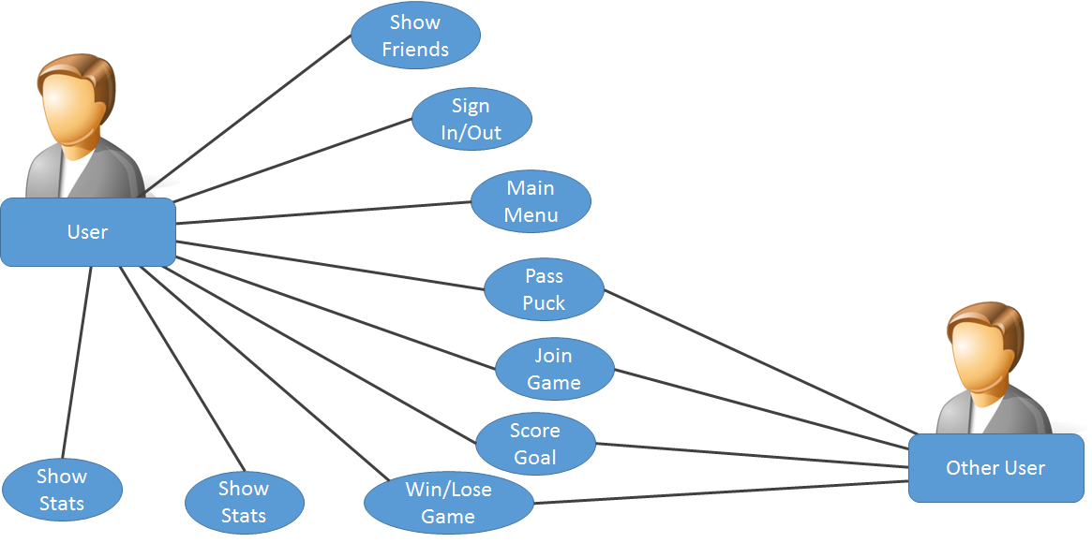

Slide 4
Class Diagrams

Slide 5
1
Package: mainMenu
Package: pages
FindAGameFragment
visible:boolean
toggleVisibility():void findGame():void
PageFragment
switchPage():void
MainActivity
setPageView()
FriendsFragment
visible:boolean friends: String[]
toggleVisibility():void friendsDropDown():void messageFrnd(name:String, message:String):void
StatsFragment
visible:boolean wins:int losses:int
toggleVisibility():void

Slide 6
2
Package: game
Package: gameControls
gameAction
GameActivity
puck : Puck goal1 : Goal goal2 : Goal obstacles : ArrayList<Obstacle> powerup : Powerup goalLimit : int timeLimit : int
updateGame()
slidingPuck
x : int y : int
setVelocity(x: int,y:int): void
scoringGoal
Points : int
addPts(): void
objectPickup
pwrup : Powerup
setAbility(pwrup:Powerup):void

Slide 7
3
Package: game
Package: gameElements
Obstacle
puckInteraction()
Element
shape : String color : Color sizeX : int sizeY : int positionX : int positionY : int
updatePosition(velocityX : int, velocityY : int) checkBounds()
GameActivity
puck : Puck goal1 : Goal goal2 : Goal obstacles : ArrayList<Obstacle> powerup : Powerup goalLimit : int timeLimit : int
updateGame()
Puck
hit(velocityX : int, velocityY : int)
Goal
scoreCondition()
Powerup
name : String
assignToPlayer(player : Player)

Slide 8
4
Package: communicationHandler
ReceiveHandler
socket : Bluetooth Socket
receiveData() parseDate()
CommunicationHandler
socket : Bluetooth Socket
sendData(dataBundle : Bundle) bundleData()
Package: game
GameActivity
puck : Puck goal1 : Goal goal2 : Goal obstacles : ArrayList<Obstacle> powerup : Powerup goalLimit : int timeLimit : int

